Slide 1


Topic 5: Skin Cancer Classification
LI TINGYOU 56490490
LUO PEIYUAN 56642728

Slide 2
Table of Contents
Data Exploration
Boosting Techniques
Model Structure
Results and Discussion

Slide 3
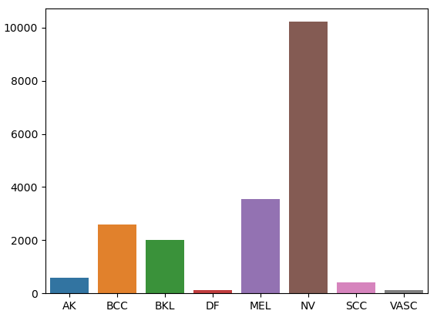
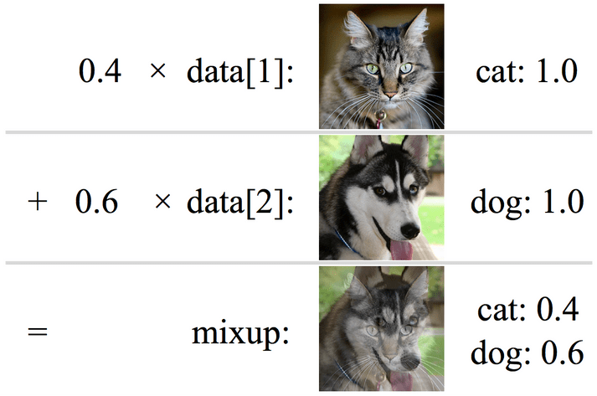
Data Exploration
Image size: 88 x 88 , RGB (3)
8 classes
Training : Test = 19597 : 800 = 25:1
Data Augmentation
Random horizontal Flip
Random vertical Flip
Random Rotate
Mix-up (Zhang et.al)
Distribution of Different Classes

Slide 4
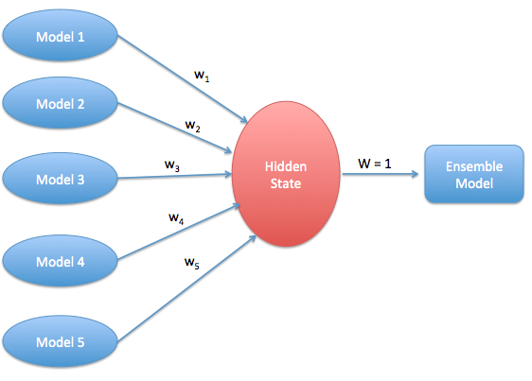
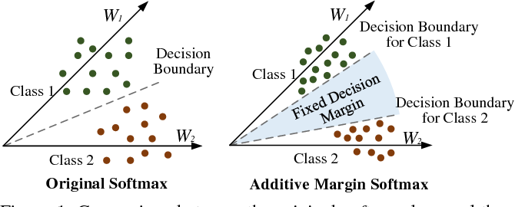
Boosting Techniques
1. SoftMax → Additive Margin SoftMax
Largen the difference between different classes
2. Single Model → Multiple Models (Ensemble)
Set different seeds to generate different models
“Vote” to predict final result

Slide 5
Model Structure
Block Structure
(512, 5, 5)
MAX Pooling Layer
Block1
Block5
Fully Connected
Augmented Data
RELU Activation
…
RELU
(88, 88, 3)
BatchNorm2d
BatchNorm1d
Convolution Layer
Dropout
Predicted Label
Ensemble
(Generated with Random Seed)
[0.02,0.01,…….0.001]
Additive Margin SoftMax

Slide 6
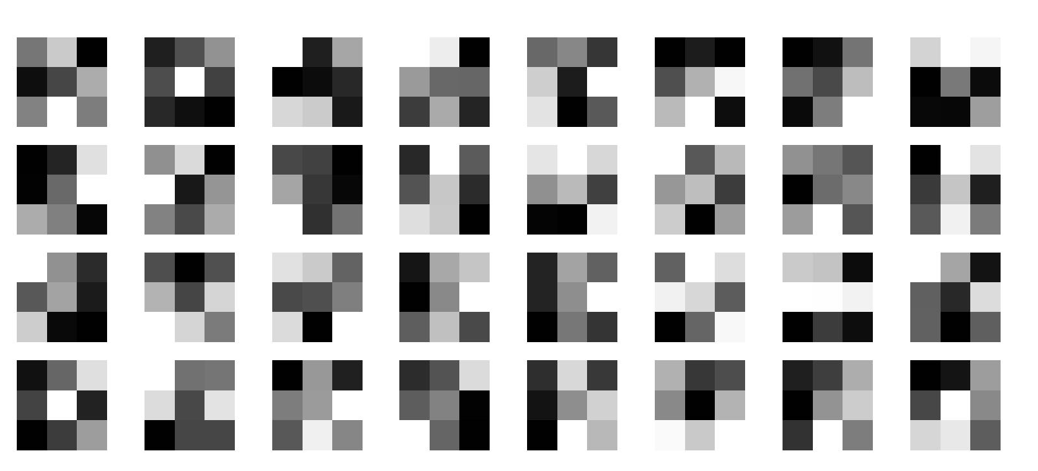
Convolutional Layer Filters Visualization (Sample)

Slide 7
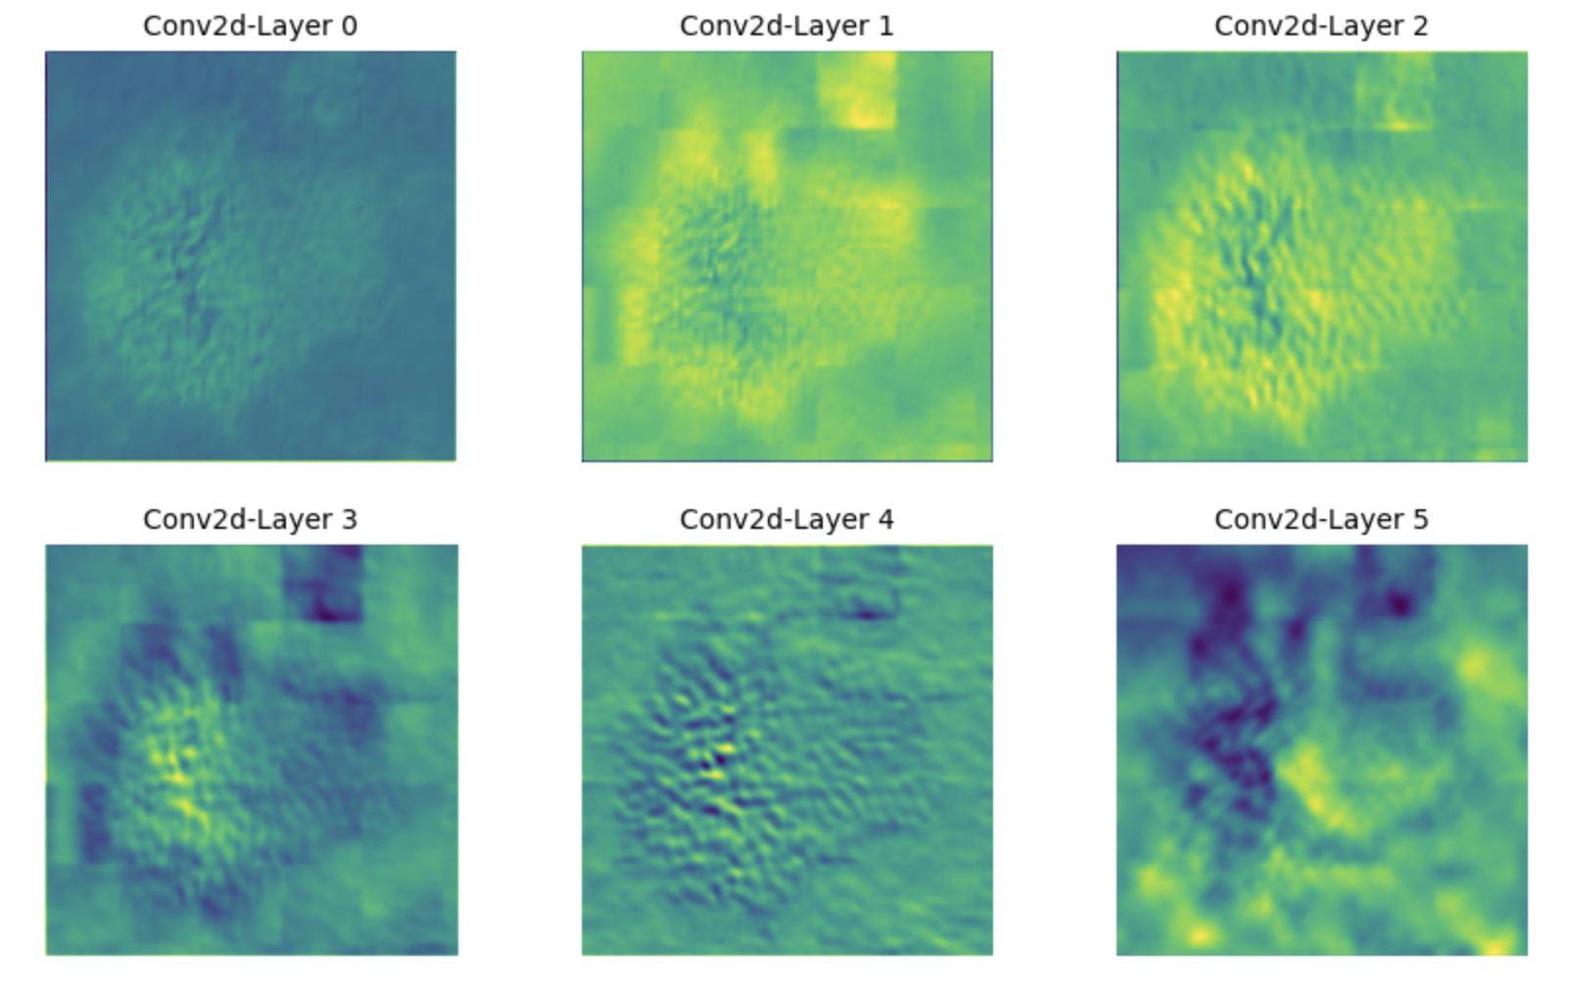
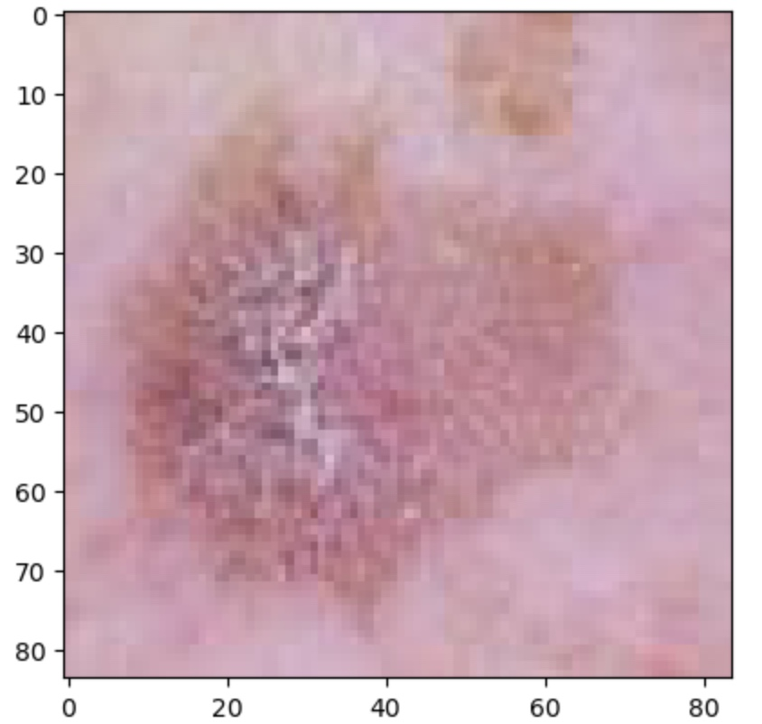
Analyze the Outputs and Feature Maps
Input Example
Source file: Test/AK/ISIC_0026709.jpg
Category: AK
Results of our model: True
Generate feature maps
Process image to every layer (6 in total) and convert 3D tensor to 2D,
Sum the same element of every channel, and then plot the
feature maps as below.
Output

Slide 8
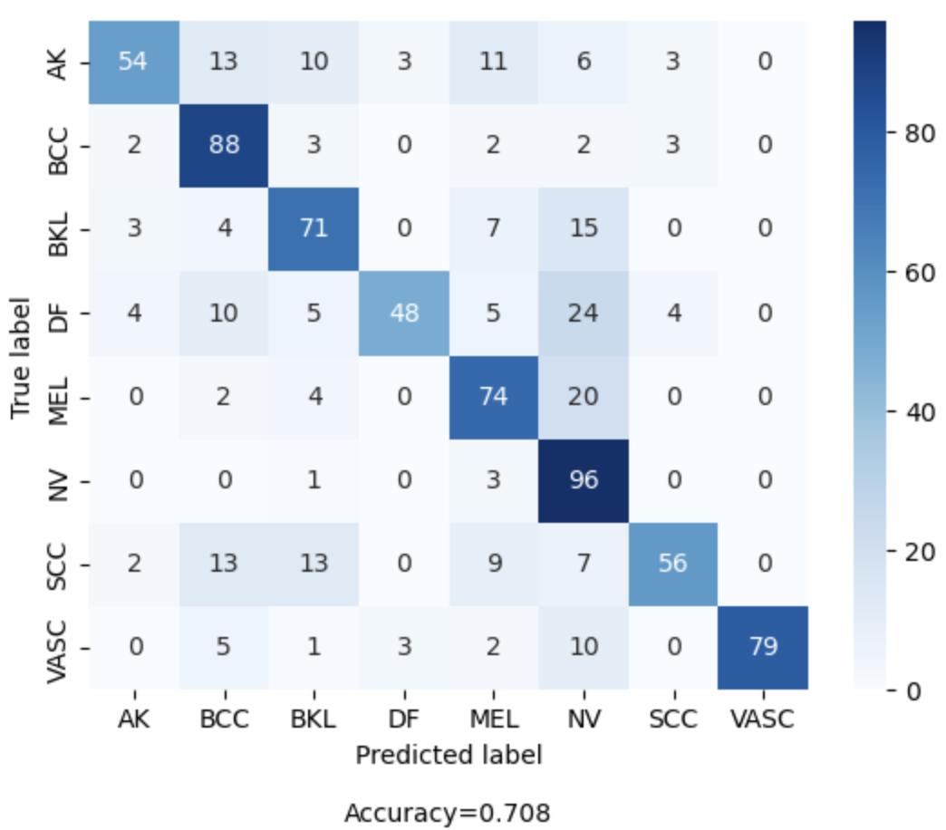
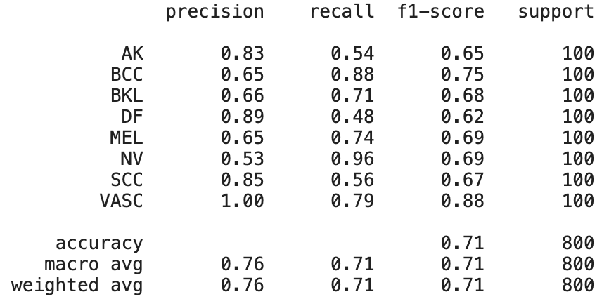
Performance of Our Model
Comparisons with different methods
Confusion Matrix
 | Running Time | Accuracy
5 – layer CNN | 12 hours | 0.62
5 – layer CNN + MixUp +Addtive Softmargin | 13 hours | 0.67
Ensemble with above Settings | 13 hours (Parallel) | 0.70
Label with the Highest Accuracy: NV(0.96)
Label with the lowest Accuracy: DF(0.48)
Overall Accuracy: 0.7075
Classification Report

Slide 9
Thank You

